Slide 1
Chapter 3 The Programming Interface
Instructor Jianhui Yue
CSE 381
Spring 2017

Slide 2
Main Points
Creating and managing processes
fork, exec, wait
Performing I/O
open, read, write, close
Communicating between processes
pipe, dup, select, connect
Example: implementing a shell

Slide 3
Functions of System Calls
Process management
Input/output
Thread management
Memory management
File systems and storage
Networking
Graphics and window management
Authentication and security

Slide 4
Shell
A shell is a job control system
Allows programmer to create and manage a set of programs to do some task
Windows, MacOS, Linux all have shells
Example: to compile a C program
cc –c sourcefile1.c
cc –c sourcefile2.c
ln –o program sourcefile1.o sourcefile2.o

Slide 5
Question
If the shell runs at user-level, what system calls does it make to run each of the programs?
Ex: cc, ln

Slide 6
UNIX Process Management
fork
to create a copy of the parent process including the context, and start it running
No arguments!
Exec(path, argcs)
to copy the new executable image to memory and start it
wait
to pause the parent process until the child is done
signal
to send a notification to another process
Notes:
UNIX splits creating a process into two steps, each of them a lot simpler.

Slide 7
UNIX Process Management
Notes:
How is this used – typically, fork a process, child and parent are now both running the same program. One sets up the child program, and runs exec – becoming the new program
The parent, usually, waits for the child to finish

Slide 8
Question: What does this code print?
int child_pid = fork();
if (child_pid == 0) { // I'm the child process
printf("I am process #%d\n", getpid());
return 0;
} else { // I'm the parent process
printf("I am parent of process #%d\n", child_pid);
return 0;
}
If fork( ) returns a non-zero, this is the parent process.
Otherwise, this is the child process.
Notes:
Parent could print first, or child could print first – you don’t know!

Slide 9
Implementing UNIX fork
Steps to implement UNIX fork
Create and initialize the process control block (PCB) in the kernel
Create a new address space
Initialize the address space with a copy of the entire contents of the address space of the parent
Inherit the execution context of the parent (e.g., any open files)
Inform the scheduler that the new process is ready to run

Slide 10
The exec family system calls
Load a new executable into the current process image.
The current process image is erased (no return if the call is successful).
For more details, ‘man –a exec’
An example: execute the executable path.
int execv(const char *path, char *const argv[]);

Slide 11
#include <stdlib.h>
#include <unistd.h>
#include <iostream>
#include <stdio.h>
#include<string.h>
main() {
char command[100];
char *argv[10];
strcpy(command, “/bin/ls”);
argv[0] = command;
strycpy(argv[1], “/”);
argv[2] = NULL;
execv(command, argv);
cout << “finished\n”;
}
(“/bin/ls /”)
How to set argv[ ]
argv[0] must always be the same as the command.
The last command argument must be followed by a NULL pointer.

Slide 12
#include <stdlib.h>
#include <unistd.h>
#include <iostream>
#include <stdio.h>
#include<string.h>
main() {
char command[100];
char *argv[10];
strcpy(command, “/bin/ls”);
argv[0] = command;
strcpy(argv[1] ,“/”);
argv[2] = NULL;
if (execv(command, argv) != -1)
std::cout << “successful!!\n”;
else
cout << “failed n”;
}
Any comment about this program?

Slide 13
The exec family system calls destroy the parent process image.
What if we want to keep the original process image (e.g. to run multiple commands?)
Fork an extra image to be destroyed by the exec system call.
#include <stdlib.h>
#include <unistd.h>
#include <iostream.h>
#include <stdio.h>
runcommand(char *command, char *argv[])
{
if (fork() == 0) {
// child process
execv(command, argv);
}
// parent process
// continue
}
Run using a child process

Slide 14
Implementing UNIX exec
Steps to implement UNIX fork
Load the program into the current address space
Copy arguments into memory in the address space
Initialize the hardware context to start execution at ``start''

Slide 15
Terminate process: exit
#include <stdlib.h>
void exit(int status);
UNIX will call this routine automatically if it is not called by the user.
The status in exit can be examined by the parent process.
UNIX convention:
All successful execution exits with code 0.
Default exit code when the end of the main() function is reached.
Exit code != 0 indicates abnormal execution.

Slide 16
Wait for a child process to stop: wait, waitpid
#include <sys/types.h>
#include <sys/wait.h>
pid_t wait(int *stat_loc);
pid_t waitpid(pid_t pid, int *status, int options);
#include <stdlib.h>
#include <unistd.h>
#include <iostream.h>
#include <stdio.h>
runforeground(char *command, char *argv[])
{
int pid, status, rpid;
if ((pid = fork()) == 0) {
// child process
execv(command, argv);
}
rpid = wait(&status);
while ((rpid!= pid) && (rpid != -1))
rpid = wait(&status);
}
#include <stdlib.h>
#include <unistd.h>
#include <iostream.h>
#include <stdio.h>
runbackground(char *command, char *argv[])
{
if (fork() == 0) {
// child process
execv(command, argv);
}
// parent process
// continue
}
Foreground running
Background running

Slide 17
Exit/wait
child parent
exit (10); wait(&stat_loc);
The status in exit can be examined in the wait. See example6.c, example7.c
status = WEXITSTATUS(stat_loc)
status = 0 for successful execution.
status != 0 for failed execution.
stat_loc also carries other information
WIFSIGNALED(stat_loc)
whether this process is killed by a signal (e.g ctrl-C).
For more information, ‘man –a wait’

Slide 18
Process manipulation system calls
fork() -- duplicate current process
execv() -- run a new executable file in the current process
wait() -- wait for the child process to finish
exit() -- terminate process
For each system call above, name one thing that is different from a typical routine call?

Slide 19
Unix Signal
Predefine signals
Sending signals
Signal handler
SIGHUP 1 /* hangup */ | SIGINT 2 /* interrupt */
SIGQUIT 3 /* quit */ | SIGILL 4 /* illegal instruction */
SIGABRT 6 /* used by abort */ | SIGKILL 9 /* hard kill */
SIGALRM 14 /* alarm clock */
SIGCONT 19 /* continue a stopped process */ | SIGCHLD 20 /* to parent on child stop or exit */

Slide 20
Sending Signals
int kill(int pid, int signal)
a system call that send a signal to a process, pid. If pid is greater than zero, the signal is sent to the process whose process ID is equal to pid. If pid is 0, the signal is sent to all processes, except system processes.
int raise(int sig)
sends the signal sig to the executing program. raise() actually uses kill() to send the signal to the executing program: kill(getpid(), sig);

Slide 21
Signal Handler
sighandler_t signal(int signum, sighandler_t handler)
It specifies the signal for its handler
handler
SIG_DFL default handler
SIG_IGN ignore the signal
A function pointer to user-defined handler

Slide 22
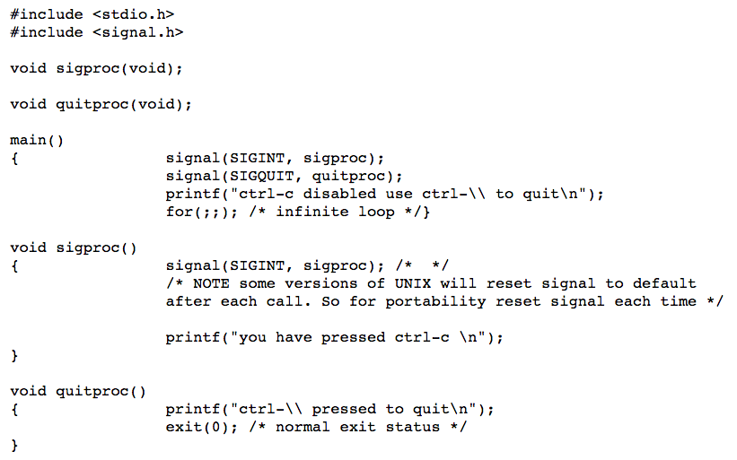
Demo 1

Slide 23
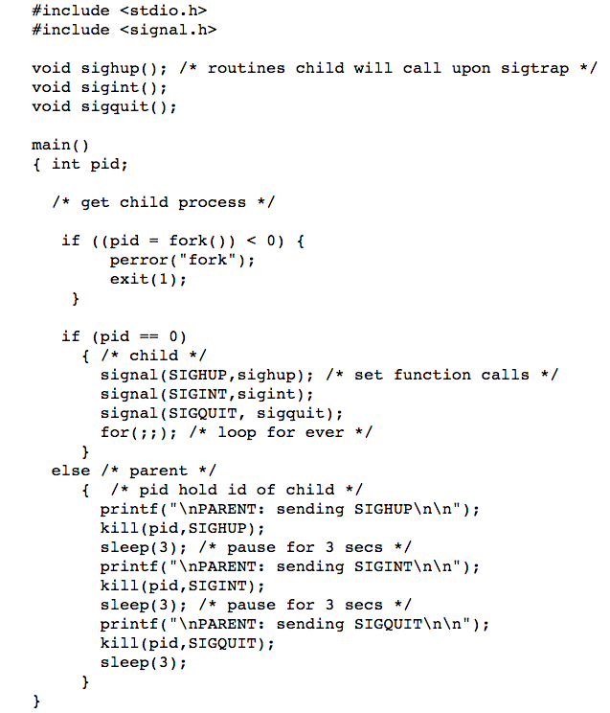
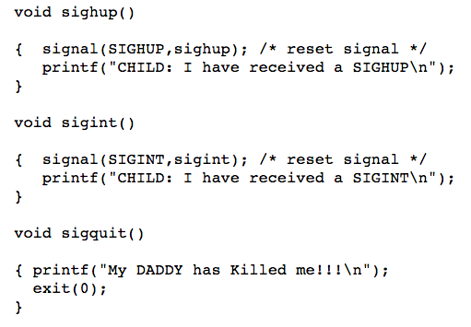
Demo 2

Slide 24
UNIX I/O
Uniformity
All operations on all files, devices use the same set of system calls: open, close, read, write
Open before use
Open returns a handle (file descriptor) for use in later calls on the file
OS checks permission and sets up internal bookkeeping
Byte-oriented
Kernel-buffered read/write
Stream data stored in kernel buffer and returned to app on demand.
Process to call read( ) blocks if data is not available
Process to call write( ) blocks if writing data too fast than device can receive.
Explicit close
To garbage collect the open file descriptor

Slide 25
Implementing a Shell
char *prog, **args;
int child_pid;
// Read and parse the input a line at a time
while (readAndParseCmdLine(&prog, &args)) {
child_pid = fork(); // create a child process
if (child_pid == 0) {
exec(prog, args); // I'm the child process. Run program
// NOT REACHED
} else {
wait(child_pid); // I'm the parent, wait for child
return 0;
}
}

Slide 26
Pipes:
two types of pipes, named pipes and unnamed pipes
name pipes:
like a file (create a named pipe (mknod), open, read/write)
can be shared by any number of processes
will not be discussed in detail.
Unnamed pipes:
an unnamed pipe does not associated with any file
can only be shared by related processes (descendants of a process that creates the unnamed pipe).
Created using system call pipe().

Slide 27
Pipes and files
Both can be used to share information among processes
Both share the file API
Performance difference:
A pipe is usually realized in memory, a file is not.
Pipe operations are memory operations, file operations are I/O operations.
Semantic difference:
A pipe is a fifo queue:
The content in a fifo queue can only be read once (the information is gone after the read operation).
A storage in a file is persistent
The content can be used many times.

Slide 28
PIPE
A UNIX pipe is kernel buffer with two file descriptors, one for writing and one reading.
Pipe( fd[2])
fd[0] is set up for reading, fd[1] is set up for writing

Slide 29
The pipe system call
open unnamed pipes
syntax
int pipe(int fds[2])
semantic
create a pipe and returns two file descriptors fds[0] and fds[1]
a read from fds[0] accesses the data written to fds[1] on a fifo basis.
the pipe has a limited size (64K in most systems) -- cannot write to the pipe infinitely.

Slide 30
#include <unistd.h>
#include <stdio.h>
main()
{
char *s, buf[1024];
int fds[2];
s = “hello world\n”;
pipe(fds);
write(fds[1], s, strlen(s));
read(fds[0], buf, strlen(s));
printf(“fds[0] = %d, fds[1] = %d\n”, fds[0], fds[1]);
write(1, buf, strlen(s));
}
/* pipe1.c */

Slide 31
#include <unistd.h>
#include <stdio.h>
main()
{
char *s, buf[1024];
int fds[2];
s = “hello world\n”;
pipe(fds);
if (fork() == 0) {
printf(“child process: \n”);
write(fds[1], s, 12); exit(0);
}
read(fds[0], buf, 6);
write(1, buf, 6);
}
/* pipe2.c : using pipe with fork*/
IPC can be used to enforce the order of the execution of processes.

Slide 32
main()
{
char *s, buf[1024]; 11111 33333 11111 33333
int fds[2]; 22222 44444 33333 11111
s = “hello world\n”; 33333 11111 22222 22222
pipe(fds); 44444 22222 44444 44444
if (fork() == 0) {
printf(“11111 \n”); /* how to make 111111 before 444444 */
read(fds[0], s, 6);
printf(“22222\n”);
} else {
printf(“33333\n”);
write(fds[1], buf, 6);
printf(“44444\n”)
}
} /* pipe3.c */

Slide 33
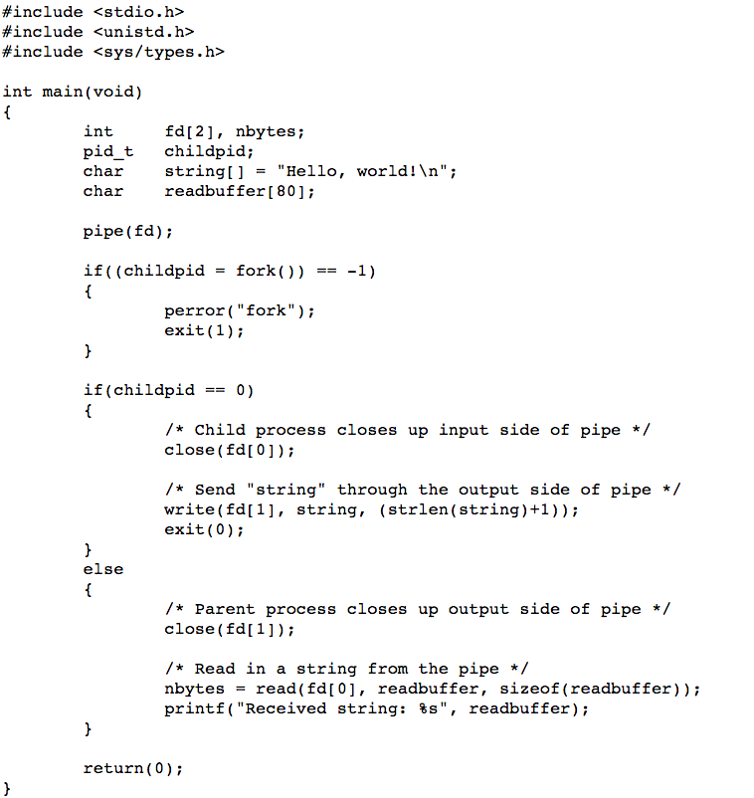
Pipe( ) example

Slide 34
Each process records all the files opened in its context, the file descriptor table in the process table entry.
Process context
process descriptor
file descriptor table
0
1
2
3
4
File info
file descriptor table contains all the files opened by the process

Slide 35
First three slots in the file descriptor table are occupied for standard I/O operation when the process is created.
Slot 0 ==> for standard input.
Slot 1 ==> for standard output.
Slot 2 ==> for standard error.
Every time UNIX searches for an available slot in the open file table, it does a linear search starting from slot 0.
The return of the first open == ?

Slide 36
Unix I/O redirection
Send output to a file
ls > tmp
Read input from a file
Zork < solution
I/O redirection: Dup2( fromFd, toFd)
creates a copy of the file descriptor fromFd, using the toFd

Slide 37
Another way of redirect a file into standard I/O
Duplicate an file descriptor: dup()
#include <unistd.h>
int dup(int fd);
return a new file descriptor having the common open file, file pointer and access mode with fd.
Note: UNIX does a linear search in the file descriptor table for the available slot.

Slide 38
Using dup() to do standard I/O redirection.
Implementing I/O redirection
#include <fcntl.h>
#include <unistd.h>
#include <iostream>
#include <stdio.h>
#include <stdlib.h>
main() {
char buf[100];
int fd;
fd = open(“tmp111”,
O_CREAT|O_WRONLY, 00777);
close(1);
dup(fd);
close(fd);
cout << “what is going on?\n”;
cerr << “1111111\n”;
} // example5.cpp

Slide 39
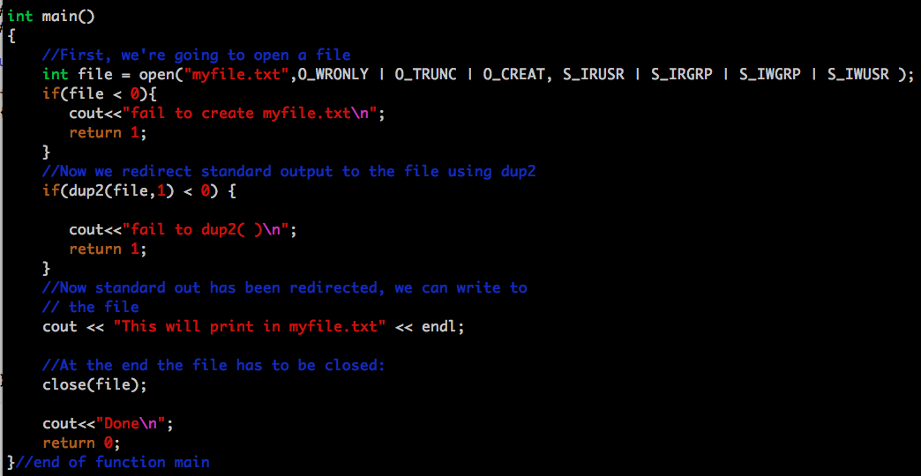
Dup2 Example

Slide 40
Interprocess Comn. Producer/Consumer
One way comm.
Producer process writes data and consumer process reads data
Each process run at its own peace
Producer is stalled if the buffer is full
Consumer is stalled if the buffer is empty

Slide 41
Client/Server for two process
Two ways communication
Create two pipes

Slide 42
Monolithic Kernel
Most OS functionality runs inside the kernel
Hardware abstraction layer
Dynamical loadable device driver

